Slide 1
Machine Learning
Introduction

Slide 2
Machine Learning: Definition
Early definition of Machine Learning
“Field of study that gives computers the ability to learn without being explicitly programmed”. Arthur Samuel (1959)
What do you mean by Explicitly Programmed ?
So, machine learning algorithms, inspired by the human learning process, iteratively learn from data, and allow computers to find hidden insights.
These models help us in a variety of tasks, such as object recognition, summarization, recommendation, and so on.

Slide 3
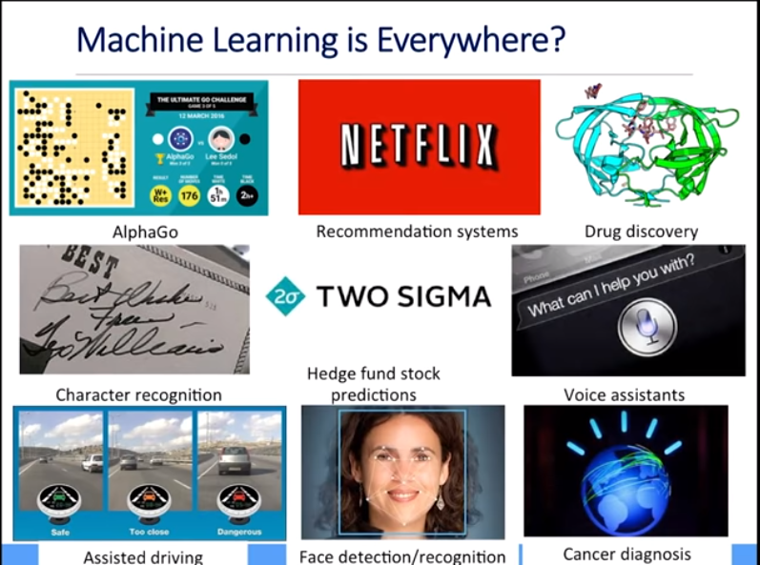

Slide 4
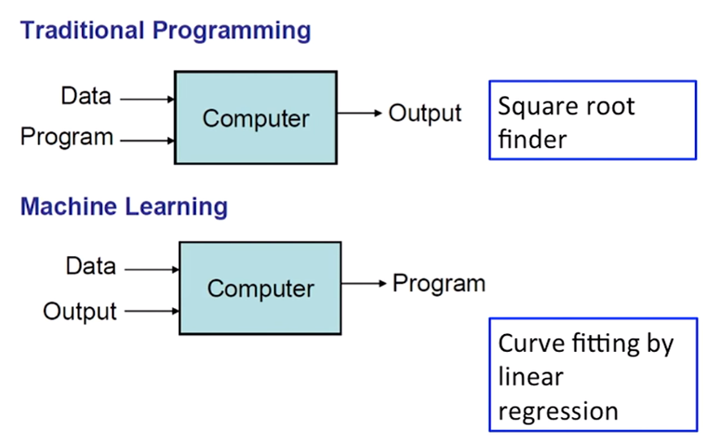
What is Machine Learning ?
Model

Slide 5
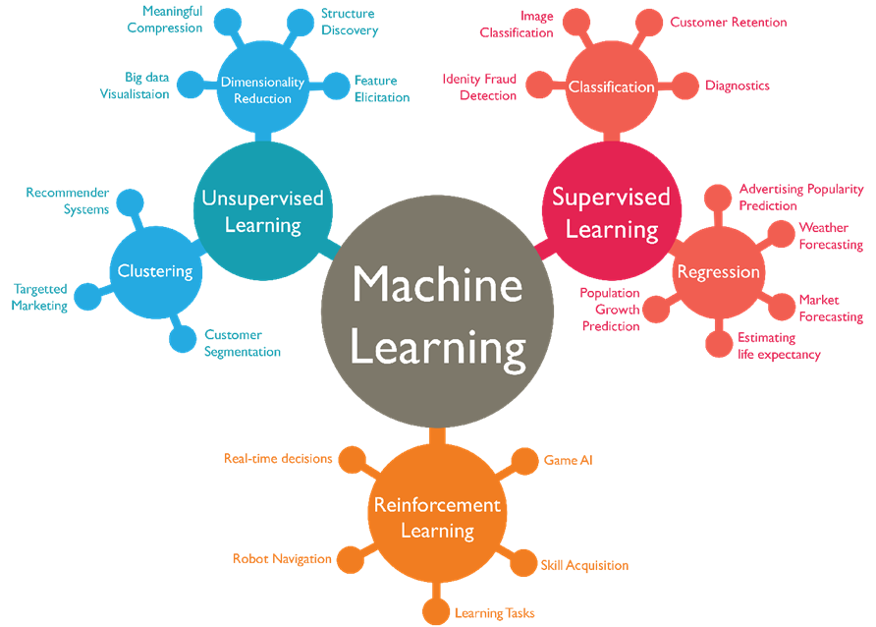

Slide 6
Generic Formulae:
f(x) = y
where ‘f’ is the Machine learning algorithm which is applied on data cases ’x’, to generate ‘y’ as prediction.
If we know what those ‘y’ values are when we're training the model, we call those the ‘labels’.

Slide 7
Data is Important
Data must be:
Relevant: relationship between data
Connected : No Missing values in data
Accurate
Enough to work with: To make detailed decisions
Structured Vs Unstructured Data

Slide 8
Data Science Stages
The stages are basically the same no matter who invents or reinvents the (knowledge discovery / data mining / big data / data science) process.
You may not always need all the stages.
Data science is an iterative process.
Backwards arrows on most process diagrams.

Slide 9
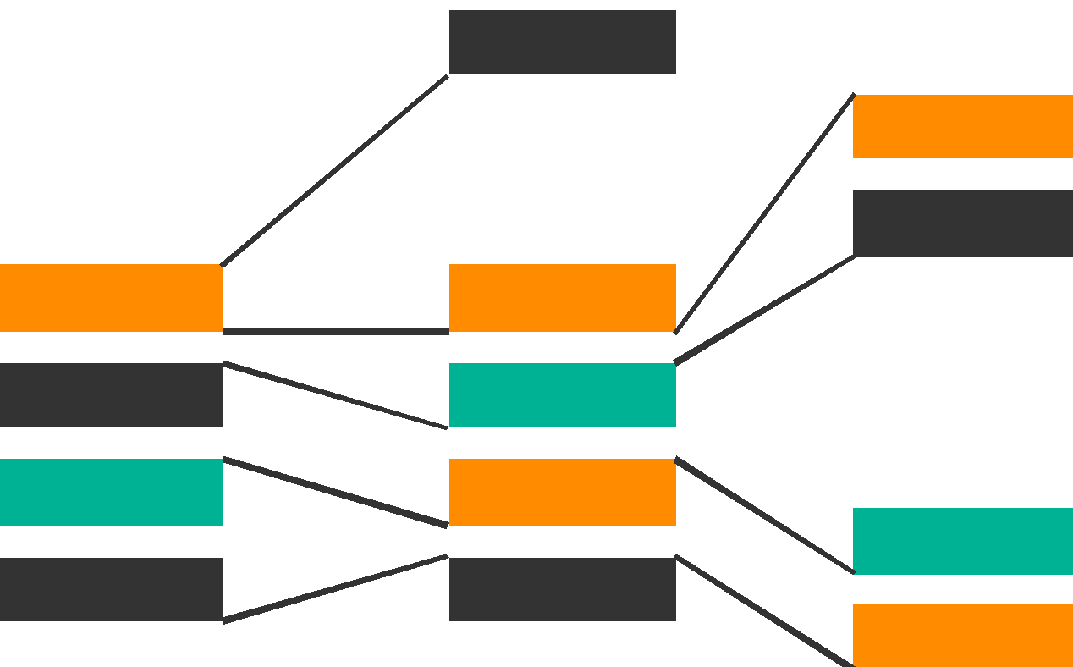
Historical Notes
KDD (Knowledge Discovery in Databases) Process
Interpretation / Evaluation
Finding useful Feature to extract data as per target
Data Mining
Transformation
Preprocessing
Information
Patterns
Selection
Transformed Data
Preprocessed Data
Target Data
Data
Based on content in “From Data Mining to Knowledge Discovery”, AI Magazine, Vol 17, No. 3 (1996)
http://www.aaai.org/ojs/index.php/aimagazine/article/view/1230

Slide 10
Model Building
Often predictive modeling means machine learning or statistical modeling
If you want to answer a yes/no question, this is classification.
For manholes, will the manhole explode next year? Y/N
If you want to predict a numerical value, this is regression.
Ex: Stock prediction at BSE Sensex tomorrow ?
If you want to group observations into similar-looking groups, this is clustering.
If you want to recommend someone an item (e.g., book/movie/product) based on ratings data from customers, this is a recommender system.
Note: There are many other machine learning problems.

Slide 11
Real World Example
This is a human cell sample extracted from a patient.
One of the interesting questions we can ask, at this point is: "Is this a Benign or Malignant cell?”
Malignant Tumour: invades surrounding tissue or spread around body; MUST be diagnosed early
Benign Tumour: Non-cancerous

Slide 12
Only a doctor with years of experience could diagnose this. Right?
Imagine that you have obtained a dataset containing characteristics of thousands of human cell samples extracted from patients who were believed to be at risk of developing cancer.
You can use the values of these cell characteristics in samples from other patients to give an early indication of whether a new sample might be benign or malignant.
This might be a potent situation where machine learning can help !

Slide 13
You should clean your data, select a proper algorithm for building a prediction model, and train your model to understand patterns of benign or malignant cells within the data.
Once the model has been trained by going through data iteratively, it can be used to predict your new or unknown cell with a rather high accuracy.
This is how machine learning helps!

Slide 14
More Real World Examples
Targeted Marketing--NETFLIX, AMAZON, YouTube etc.
Fraud Detection--Banks making decision while approving a loan application.
Customer Churn--Companies use their customer’s demographic data to segment them, or predict if they will unsubscribe from their company the next month.
SPAM Detection
And many more!

Slide 15
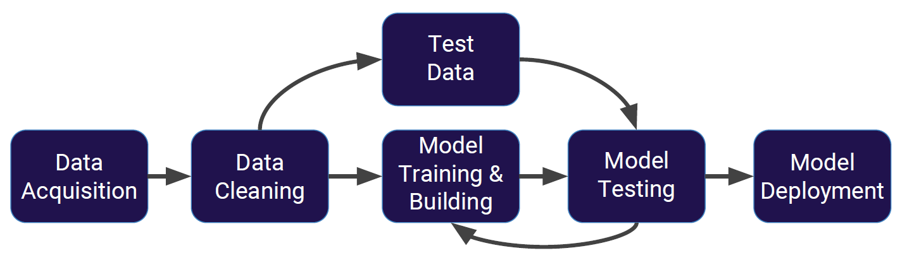
Machine Learning Process

Slide 16
Python for Machine Learning: Libraries
There are a lot of modules and libraries already implemented in python that can make out life much easier.
Few necessary python packages and libraries which are required are:
Numpy, which is a math library to work with n-dimensional arrays in Python.
It enables you to do computation efficiently and effectively.
For example, for working with arrays, dictionaries, functions, datatypes, and working with images, you need to know Numpy.

Slide 17
Python for Machine Learning: Libraries
SciPy is a collection of numerical algorithms and domain-specific toolboxes, including signal processing, optimization, statistics and much more.
Matplotlib is a very popular plotting package that provides 2D plotting as well as 3D plotting.
Basic Knowledge about these 3 packages, which are built on top of python, is a good asset for data scientists who want to work with real world problems.

Slide 18
Python for Machine Learning: Libraries
Pandas library, is a very high-level python library that provides high-performance, easy to use data structures.
It has many functions for data importing, manipulation and analysis.
In particular, it offers data structures and operations for manipulating numerical tables and time series.
Scikit-learn is a collection of algorithms and tools for machine learning.

Slide 19
Scikit-Learn Library
Scikit-learn is a free machine learning library for the Python programming language.
It has most of the classification, regression and clustering algorithms, and it is designed to work with the Python numerical and scientific libraries, NumPy and SciPy.
Most of the tasks that need to be done in a machine learning pipeline are implemented already in scikit learn, including, pre-processing of data, feature selection, feature extraction, train/test splitting, defining the algorithms, fitting models, tuning parameters, prediction, evaluation, and exporting the model.

Slide 20
Implementing Scikit-learn Library : Example
Let’s look how to use Scikit-Learn library.
Basically, Machine learning algorithms benefit from standardization of the data set.
If there are some outliers, or different scales fields in your data set, you have to fix them.
The preprocessing package of scikit learn provides several common utility functions and transformer classes to change raw feature vectors into a suitable form of vector for modeling.
from sklearn import preprocessing
X = preprocessing.StandardScaler().fit(X).transform(X)

Slide 21
Implementing Scikit-learn Library : Example
Now, you have to split your dataset into train and test sets to train your model, and then test the model’s accuracy separately.
from sklearn.model_selection import train_test_split
X_train, X_test, y_train, y_test=train_test_split(X, y, test_size=0.33)
Then, you can setup your algorithm.

Slide 22
Implementing Scikit-learn Library : Example
For example, you can build a classifier using a support vector classification algorithm.
from sklearn import svm clf=svm.SVC(gamma=0.001, C=100)
We call our estimator instance clf, and initialize its parameters.
Now, you can train your model with the train set.
By passing our training set to the fit method, the clf model learns to classify unknown cases.
clf.fit(X_train, y_train)

Slide 23
Implementing Scikit-learn Library : Example
Then, we can use our test set to run predictions.
clf.predict(X_test)
And, the result tells us what the class of each unknown value is.
Also, you can use different metrics to evaluate your model accuracy, for example, using a confusion matrix to show the results.
from sklearn.metrics import confusion_matrix
print(confusion_matrix(y_test, yhat, labels=[1,0]))
And finally, you save your model.
import pickle
s=pickle.dumps(clf)

Slide 24
Supervised algorithms Vs Unsupervised algorithms

Slide 25
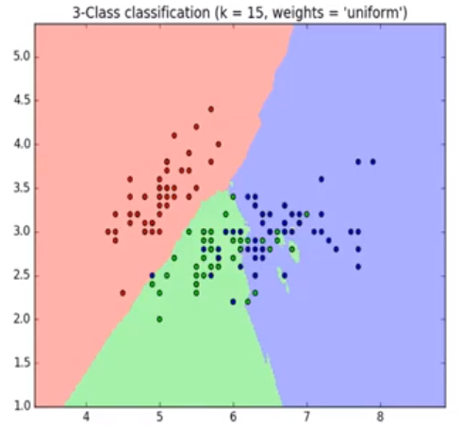
Supervised & Unsupervised algorithms
We supervise a machine learning model by teaching (or training) the model with some data, from a labeled dataset.
That is, we teach the model (load the model) with knowledge so that we can use knowledge to predict unknown or future instances.

Slide 26
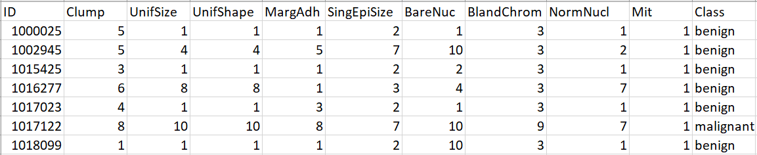
The columns are called Features, which include the data.
If you plot this data, and look at a single data point on a plot, it have all of these attributes.
That would make a row on this chart, also referred to as an observation.

Slide 27
You may have two kinds of value of the data.
numerical.
Categorical.

Slide 28
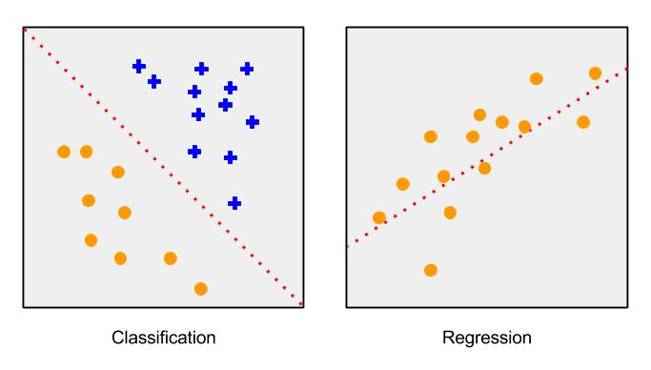
Supervised Algorithms
There are two types of Supervised Learning techniques.
They are: classification and regression.
Classification is the process of predicting a discrete class label or category.
Regression is the process of predicting a continuous value as opposed to predicting a categorical value in Classification.

Slide 29
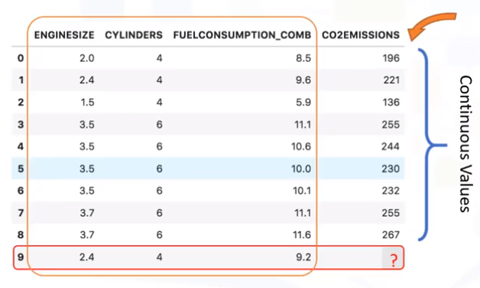
This dataset is related to Co2 emissions of different cars.
Given this dataset, you can use regression to predict the Co2 emission of a new car by using other fields, such as Engine size or number of Cylinders.

Slide 30
Unsupervised Algorithms
In Unsupervised learning, we do not supervise the model, but we train the model on the dataset to discover information that may not be visible to the human eye, on Unlabeled Data.
The system is not told the "right answer" ; algorithm must figure out what is being shown.
The goal is to explore the data and find some structure within or it can find the main attributes that separate segments from each other.

Slide 31
Popular Machine Learning Techniques
Dimensionality Reduction and/or feature selection play a large role by reducing redundant features to make the classification easier.
Market basket analysis is a modelling technique based upon the theory that if you buy a certain group of items, you are more likely to buy another group of items.
Density estimation is a very simple concept that is mostly used to explore the data to find some structure within it.
Clustering is considered to be one of the most popular unsupervised machine learning techniques used for grouping data points or objects that are somehow similar.

Slide 32
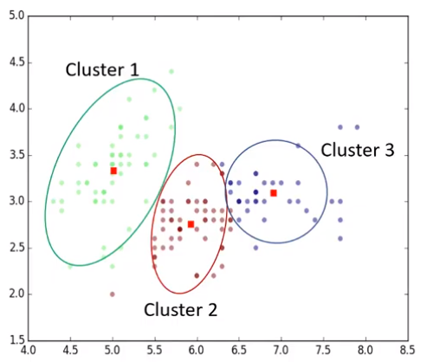
Cluster analysis has many applications in different domains, whether it be a bank’s desire to segment its customers based on certain characteristics, or helping an individual to organize and group his/her favorite types of music!

Slide 33
Reinforcement learning is often used for robotics, gaming and navigation.
With reinforcement learning, the algorithm discovers through trial and error which actions yield the greatest rewards.
This type of learning has three primary components:
the agent (the learner or decision maker),
the environment (everything the agent interacts with) and
actions (what the agent can do).

Slide 34
Writing “Hello World” Machine Learning Code in Only 6 Lines!
Write a code to differentiate between Apples & Oranges ?

Slide 35
Training Data
Features
Input of classifier
Output of classifier
Weight | Texture | Label
150g | Bumpy | Orange
170g | Bumpy | Orange
140g | Smooth | Apple
130g | Smooth | Apple
… | … | …
import sklearn
features = [[140,"smooth"],[130,"smooth"],[150,"bumpy"],[170,"bumpy"]]
labels = ["apples", "apples", "orange", "orange"]
Change strings to integers

Slide 36
First 3 lines of code !
import sklearn
features = [[140, 1], [130, 1], [150, 0], [170, 0]]
labels = [0, 0, 1, 1]
0: bumpy ; 1: smooth
0: apple ; 1: orange

Slide 37
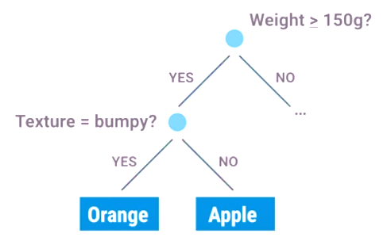
Classifier
Box of RULES
Learning Algorithms are the procedure that creates RULES, by finding patterns in your training DATA.
Ex: It creates RULE that heavier fruit is more likely to be an orange!
Decision Tree

Slide 38
from sklearn import tree
features = [[140, 1], [130, 1], [150, 0], [170, 0]]
labels = [0, 0, 1, 1]
clf = tree.DecisionTreeClassifier()
clf = clf.fit(features, labels)
print(clf.predict([[150, 0]]))
0: bumpy ; 1: smooth
0: apple ; 1: orange
Classifier gets trained on input data

Slide 39

Please contact
Foundation for Innovation and Collaborative
Education
mentor@fice.in
www.fice.in
Please contact
Foundation for Innovation and Collaborative
Education
info@fice.in
mentor@fice.in
Notes:
Here are the lessons we are going to learn today.

